Slide 1
Data Structure
Binary Search Tree

Slide 2
Binary Search Tree(BST)
Is also a Binary Tree such that:
Every node entry has a unique key (i.e. no duplication item).
All the keys in the left subtree of a node are less than the key of the node.
All the keys in the right subtree of a node are greater than the key of the node.

Slide 3
Binary Search Tree (BST)
Is a Binary Tree such that:
Every node entry has a unique key (i.e. no duplication item).
All the keys in the left subtree of a node are less than the key of the node.
All the keys in the right subtree of a node are greater than the key of the node.
Integer Key
String Key
43
Fred
31
64
Dan
Mary
20
40
56
89
Alan
Eve
Kate
Sue
28
33
47
59
Bill
Eric
Greg
Len

Slide 4
Example 1:
key is an integer
43
31
64
20
40
56
89
28
33
47
59

Slide 5
Example 2:
key is a string
Fred
Dan
Mary
Alan
Eve
Kate
Sue
Bill
Eric
Greg
Len

Slide 6
BST - Insert
Fred
Mary
Kate
Dan
Len
Alan
Eve
Bill
Sue
Greg
Eric
43
31
64
40
20
89
56
47
33
28
59
Integer Key
String Key
Fred
43
>
<
>
<
31
64
Dan
Mary
>
<
>
<
>
<
>
<
20
40
56
89
Alan
Eve
Kate
Sue
<
>
>
<
<
>
>
<
28
33
47
59
Bill
Eric
Greg
Len

Slide 7
BST - Search
Search Elements 59 and 42
43 > 42
43
43 < 59
31
31 < 42
64 > 59
64
20
40
56
56 < 59
89
40 < 42
? 42
28
33
47
59
59 = 59

Slide 8
BST - Delete
Node with two children :The strategy is to replace the data of this node with the smallest data of the right subtree / largest data of left subtree and recursively delete that node.
43
Delete 47 (leaf node);
Delete 40 (have only one child);
Delete 64 and 31 (have both child).
64
32
59
31
Node with one child: connect the parent to the child and Delete
20
40
56
89
Node with two children : The strategy is to replace the data of this node with the smallest data of the right subtree / largest data of left subtree and recursively delete that node.
28
38
47
59
Leaf Node: Just Delete
Leaf Node: Just Delete
Node with one child: connect the parent to the child and Delete
32
33

Slide 9
Binary search tree construction algorithm:
Start with a tree containing just one Node (the root).
To add a new item, do the following until the end of list (stop):
Step 1:If item < root_item:
If root_item has a left child then move to the left (root_item = root_item_left) and repeat step 1.
Else add a new left child with this item. Stop.
Else If item > root_item:
If root_item has a right child then move to the right (root_item = root_item_right) step 1.
Else add a new right child with this item. Stop.
Example : Make a BST with the following list.
5 9 8 1 2 4 6 10

Slide 10
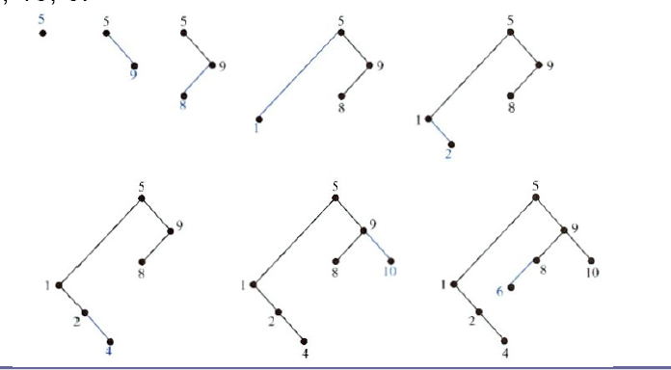
Example : Make a BST with the following list.
5 9 8 1 2 4 6 10

Slide 11
Exercises :
Construct a binary search tree for the words mathematics, physics, geography, zoology, meteorology, geology, psychology, and chemistry using alphabetical order.
Build a binary search tree for the words banana, peach, apple, pear, coconut, mango, and papaya using alphabetical order.

Slide 12
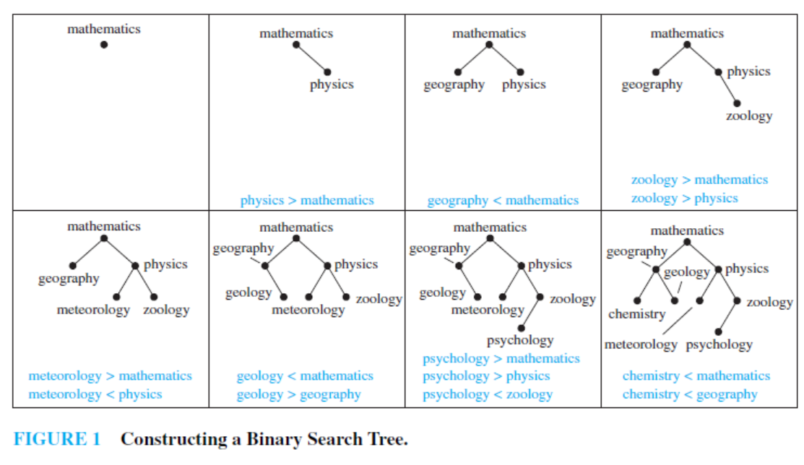
Answer 1:

Slide 13
Insert a node into a BST (example)
57
43
31
64
20
40
56
89
28
33
47
59

Slide 14
Insert (example )
57
43
31
64
20
40
56
89
28
33
47
59
57

Slide 15
Search: Checklist
if target key is less than current node’s key, search the left sub-tree.
else, if target key is greater than current node’s key, search the right sub-tree.
returns:
if found, pointer to node containing target key.
otherwise, NULL pointer.

Slide 16
Search
Example:
59
43
31
64
20
40
56
89
28
33
47
59
57
found
16

Slide 17
Search
Example:
61
43
31
64
20
40
56
89
28
33
47
59
57
failed

Slide 18
Deleting a node in BST
As is common with many data structures, the hardest operation is deletion.
Once we have found the node to be deleted, we need to consider several possibilities.
If the node is a leaf, it can be deleted immediately.
If the node has one child, the node can be deleted after its parent adjusts a pointer to bypass the node and connect to in-order successor (child).
The complicated case is when the node to be deleted has both left and right subtrees. The strategy is to replace the data of this node with the smallest data of the right subtree and recursively delete that node.

Slide 19
BST - Delete
Node with two children :The strategy is to replace the data of this node with the smallest data of the right subtree / largest data of left subtree and recursively delete that node.
43
Delete 47 (leaf node);
Delete 40 (have only one child);
Delete 64 and 31 (have both child).
64
32
59
31
Node with one child: connect the parent to the child and Delete
28
40
56
89
Node with two children : The strategy is to replace the data of this node with the smallest data of the right subtree / largest data of left subtree and recursively delete that node.
20
38
47
59
Leaf Node: Just Delete
Leaf Node: Just Delete
Node with one child: connect the parent to the child and Delete
32
33

Slide 20
Example of BST
43
Two child
31
Two child
64
Two child
One child
Two child
20
One child
40
56
89
Leaf
28
33
Leaf
47
59
Leaf
Leaf
Leaf

Slide 21
1. Deleted node 33 (node is a leaf)
43
31
64
20
40
56
89
28
Leaf node
47
59

Slide 22
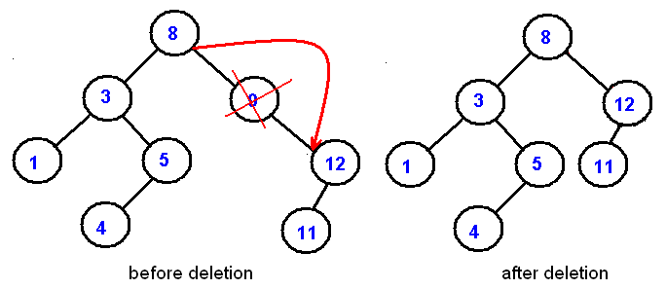
2. Deleted node 9 (node has one child)
this node can be deleted after its parent adjusts a pointer to bypass the node and connect to inorder successor.
(Inorder successor of a node is the next node in Inorder traversal of the Binary Tree.)

Slide 23
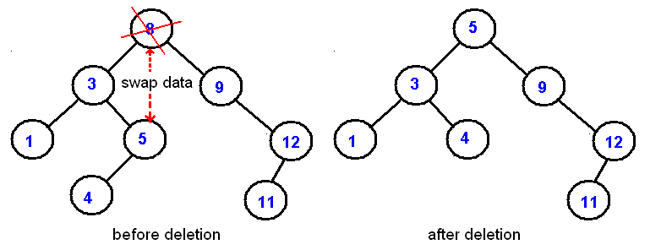
3. Deleted node 9 (node has both left and right subtrees)
The strategy is to replace the data of this node with the smallest/largest data of the right/left subtree and recursively delete that node.
and delete this node

Slide 24
Binary Tree implementation by linked list
entry
link to right
child node
link to left
child node

Slide 25
Data type of a Tree Node
struct treenode
{
int data;
struct treenode *left, *right;
};
struct treenode *root, *ptr;
void make_root(int x); //to make the root node
void make_node(int x); //to make node
void inorder(treenode *p); //to display the tree

Slide 26
main() Function for BST creation
int main()
{
root=NULL;
int x;
while(1)
{ cout<<"Enter data or -1 for exit: ";
cin>>x;
if(x == -1) break;
else
{ if(root==NULL)
{ make_root(x);}
else
{ make_node(x);}
}
}
inorder(root);//to display the tree
return 0;
}

Slide 27
void make_root(int x) { root=new treenode; root->data=x; root->left=NULL; root->right=NULL; }
Make_root() Function for root creation

Slide 28
void make_node(int x) { struct treenode *np = new treenode; np->data=x; np->left=NULL; np->right=NULL; ptr=root; while(ptr!=NULL) { if(ptr->data==x) break; else if (ptr->data>x) { if(ptr->left==NULL)//if left child NULL then link node as left child { ptr->left=np; break; } else ptr=ptr->left; //move left } else if (ptr->data<x) { if(ptr->right==NULL) // if right child NULL then link node as right child { ptr->right=np; break;} else ptr=ptr->right; //move right } }}
Make_node() Function for other node creation
cout<< "Duplicate data\nEnter data again ";
cin>>x;//new data to avoid duplicate one
np->data=x;
ptr=root;//start again from root data

Slide 29
main() Function for BST creation (Search Operation)
int main()
{
root=NULL;
inorder(root);//to display the tree
insert();
int item; cout<<"\nEnter item want to search:"; cin>>item;
ptr = search(item); //function will return a pointer
if(ptr!=NULL)
cout<<item<<“ Found”<<endl;
else
cout<<item<<“ not Found”<<endl;
return 0;
}

Slide 30
void insert() { int x; cout<<"Enter data want to insert:"; cin>>x; make_node(x); cout<<“After insertion ”<<x<<endl; inorder(root);//to display the tree }
insert() Function for insertion a node

Slide 31
*treenode search(int item) //use void for non-returnable function { struct treenode *p; p=root; while(p!=NULL) { if(p->data==item){cout<<"Found \n"; return p; //break;} else if(p->data>item) { if(p->left==NULL) {cout<<"Not found \n"; return p; //break; } else { p=p->left; } } else if(p->data<item) { if(p->right==NULL) {cout<<"Not found \n"; return p; //break; } else { p=p->right; } } }}
search() Function for searching a node

Slide 32
Inorder Traversal (recursive version)
A / B * C * D + E
void inorder(TreeNode *ptr)
{
if(root == NULL){
cout<<"Tree is empty"<<endl;
return;
}
if (ptr!=NULL) {
inorder(ptr->left);
cout << ptr->data;
indorder(ptr->right);
}
}
+
*
E
*
D
/
C
A
B

Slide 33
void inorder(TreeNode *ptr) &50
{
if(root == NULL){
cout<<"Tree is empty"<<endl;
return;
}
if (ptr!=NULL) {
inorder(ptr->left);
cout << ptr->data;
indorder(ptr->right);
}
}
void inorder(TreeNode *ptr) NULL
{
if(root == NULL){
cout<<"Tree is empty"<<endl;
return;
}
if (ptr!=NULL) {
inorder(ptr->left);
cout << ptr->data;
indorder(ptr->right);
}
}
void inorder(TreeNode *ptr) &70
{
if(root == NULL){
cout<<"Tree is empty"<<endl;
return;
}
if (ptr!=NULL) {
inorder(ptr->left);
cout << ptr->data;
indorder(ptr->right);
}
}
NULL
&60
&40
&70
&80
void inorder(TreeNode *ptr) &40
{
if(root == NULL){
cout<<"Tree is empty"<<endl;
return;
}
if (ptr!=NULL) {
inorder(ptr->left);
cout << ptr->data;
indorder(ptr->right);
}
}
void inorder(TreeNode *ptr) NULL
{
if(root == NULL){
cout<<"Tree is empty"<<endl;
return;
}
if (ptr!=NULL) {
inorder(ptr->left);
cout << ptr->data;
indorder(ptr->right);
}
}
void inorder(TreeNode *ptr) &60
{
if(root == NULL){
cout<<"Tree is empty"<<endl;
return;
}
if (ptr!=NULL) {
inorder(ptr->left);
cout << ptr->data;
indorder(ptr->right);
}
}
NULL
NULL
NULL

Slide 34
void inorder(TreeNode *ptr) NULL
{
if(root == NULL){
cout<<"Tree is empty"<<endl;
return;
}
if (ptr!=NULL) {
inorder(ptr->left);
cout << ptr->data;
indorder(ptr->right);
}
}
void inorder(TreeNode *ptr) NULL
{
if(root == NULL){
cout<<"Tree is empty"<<endl;
return;
}
if (ptr!=NULL) {
inorder(ptr->left);
cout << ptr->data;
indorder(ptr->right);
}
}
void inorder(TreeNode *ptr) NULL
{
if(root == NULL){
cout<<"Tree is empty"<<endl;
return;
}
if (ptr!=NULL) {
inorder(ptr->left);
cout << ptr->data;
indorder(ptr->right);
}
}
void inorder(TreeNode *ptr) & 80
{
if(root == NULL){
cout<<"Tree is empty"<<endl;
return;
}
if (ptr!=NULL) {
inorder(ptr->left);
cout << ptr->data;
indorder(ptr->right);
}
}
void inorder(TreeNode *ptr) NULL
{
if(root == NULL){
cout<<"Tree is empty"<<endl;
return;
}
if (ptr!=NULL) {
inorder(ptr->left);
cout << ptr->data;
indorder(ptr->right);
}
}
NULL
NULL

Slide 35
Preorder Traversal (recursive version)
+ * * / A B C D E
void preorder(TreeNode *ptr)
{
if(root == NULL){
cout<<"Tree is empty"<<endl;
return;
}
if (ptr!=NULL) {
cout << ptr->data;
preorder(ptr->left);
predorder(ptr->right);
}
}
+
*
E
*
D
/
C
A
B

Slide 36
Postorder Traversal (recursive version)
A B / C * D * E +
void postorder(TreeNode *ptr)
{
if(root == NULL){
cout<<"Tree is empty"<<endl;
return;
}
if (ptr!=NULL) {
postorder(ptr->left);
postdorder(ptr->right);
cout << ptr->data;
}
}
+
*
E
*
D
/
C
A
B

Slide 37
What is a Balanced Tree?
How to determine if a binary tree is balanced/height-balanced?
Self Study.
Find out yourself.

